Slide 1
Visioning Update
Third Church
January 10, 2016
@KevinGrahamFord
www.tagconsulting.org

Slide 2
Agenda: 10-12
Orientation to the Process
Our Core Values
Our SWOT
Our Emerging Focus
Our Strategic Priorities
Next Steps

Slide 3
The Process
Staff Assessment (The Engagement Dashboard; Prevailing Talents);
Nine (9) focus groups of leaders and members;
Demographic Study of 5 and 15 mile radius
Three and weekend retreats with strategic planning team;
Today – 30,000 foot summary;
After today – email and verbal feedback, input, and questions;
Finalize long term priorities and medium-term initiatives, led by teams.
Pray! Pray! Pray!

Slide 4
The Goal: Alignment around our Identity

Slide 5
Leadership
The first task of leadership is to distinguish between what needs to be preserved and what needs to change.
Preserve
Change

Slide 6
Code

Slide 7
Our Core Values

Slide 8
BIBLICAL FAITHFULNESS
We are rooted in Scripture, believing that God speaks through his living and active Word today, just as he has in the past. In a time when many struggle to find meaning and direction, we believe that the Bible tells the true story of the triune God, the world, and ourselves, and we endeavor to live humbly and responsively within that story.

Slide 9
GOSPEL COMMUNITY
We are bound together in our differences through the gospel of Jesus Christ. We seek to live as an authentic spiritual family that crosses generational, cultural, and vocational lines. By loving one another, we bear witness to the power of Jesus’ life, death, and resurrection to reconcile us to God and neighbor.

Slide 10
INTENTIONAL DISCIPLESHIP
We are growing as Christ-followers, equipping one another for deep understanding of the faith and faithful living in every dimension of life. Training hearts, minds and hands, we aim to cultivate spiritual maturity, encourage one another towards wisdom, and help every person be transformed into the likeness of Jesus.

Slide 11
MISSIONAL ORIENTATION
We are sent out in the power of the Holy Spirit to proclaim the good news of Jesus, his grace, and his Kingdom, and to join in God’s work of restoration. We lovingly engage and sacrificially give ourselves to advance the shalom of metro Richmond and the world.

Slide 12
CATALYTIC CULTURE
We are creating partnerships that invite others into the broader movement of God, focusing on the growth of the Kingdom more than that of Third Church. We foster an entrepreneurial, risk-taking culture to equip and release Spirit-led leaders to seed our region and world with new ministries, communities and institutions for the common good.

Slide 13
Strengths to Leverage
Resources—Financial, People, Building & Location
Biblical Teaching/Living, Strong Theological Foundations
Missions Focus and Missional Identity
Catalytic Culture and History
Intergenerational Community
Discipleship Emphasis

Slide 14
Weaknesses to Address
Facilities and Infrastructure (including technology)
Unclear and complex staff and session structures and roles
Connections/path of discipleship
Poor communication of vision
Lack of diversity

Slide 15
TAG’s Assessment: Governance and Structure
“Lines of authority and responsibility are clear in this organization” scored in the 11th percentile with a 40% negative response.

Slide 16
The S-Curve

Slide 17
In the Maturity Phase

Slide 18
The New S-Curve

Slide 19
Opportunities to Consider
Catalytic relationships in the city and beyond
Neighborhood training center
Forum/lecture program
Arts and culture series
Intern/artist/resident program
Biblical training model on Sundays
Empower lay model through Parish model

Slide 20
Opportunities to Consider
Become a story-telling community
Plant churches
Creative use of facilities

Slide 21
Threats to Prevent
Culture of busy-ness
Pride in success and growth (self-reliance, rather than relying on the Holy Spirit)
Inwardly strong enough to be outwardly focused?
Financial + aging congregation
Lack of clear path of discipleship and some groups are closed
Lack of cultural diversity

Slide 22
Threats to Prevent
Becoming Pastor-centric
Losing focus – doing too many things
Getting lost in management of programs and facilities
Leaving older and younger people in the wake of change

Slide 23
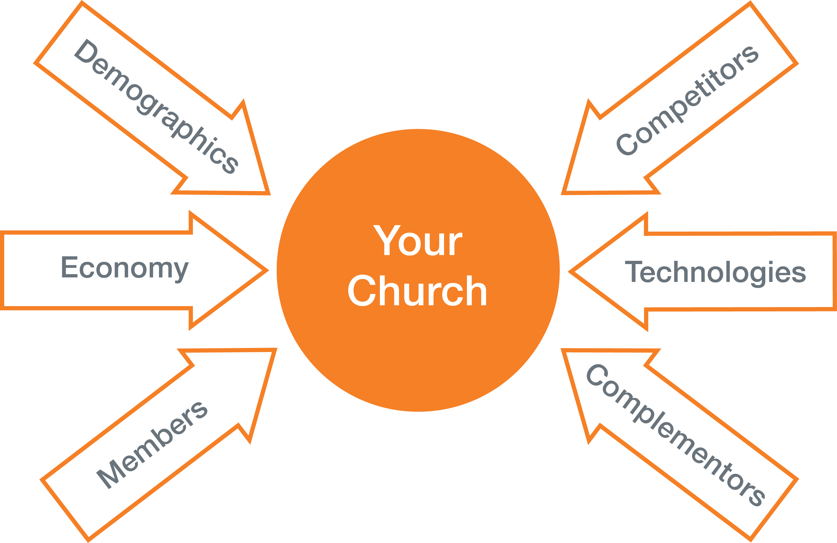
External Disruptions
Things that are impacting Third Church
Notes:
Examples from the business world. Regulatory in Banking , Netscape in digital, graphically interface to pictures. Economy crash in 2001. What has changed in our world that we are not paying attention to.

Slide 24
Changing Societies and Cultures
Era: | Oral | Print | Broadcast | Digital
Medium: | Person | Book | TV | Internet
Value: | Authority | Reason | Experience | Engagement
Cultural Mirror: | Monarchy | Town Hall | Business | Social Network
Metaphor: | Courtroom | Classroom | Concert | Café
Social Form: | Gather | Discuss | Observe | Collaborate

Slide 25
Our Emerging Focus for the Medium Term
Orient around relationships for community, discipleship and mission.

Slide 26
Strategic Objectives: 5-10 Years

Slide 27
1. COMMUNICATE OUR PURPOSE
“Where there is no vision, the people perish.” Proverbs 29:18 (KJV)
What is our particular calling as a church?

Slide 28
2. REORGANIZE STAFF & SESSION
“Now you are the body of Christ, and individually members of it.”
1 Cor. 12:27
How do we best fulfill our God-given responsibilities?

Slide 29
3. CONNECT, TRAIN & SEND
“Let us consider how to stir up one another to love and good works, not neglecting to meet together…but encouraging one another.” Hebrews 10:24-25
How does a person get involved, grow and serve at Third and beyond?

Slide 30
4. MODERNIZE INFRASTRUCTURE
“The earth is the Lord’s,
and everything in it.”
Psalm 24:1
How will we wisely steward
what God has given?

Slide 31
5. LOVE OUR NEIGHBORS
“I tell you, open your eyes and look at the fields! They are ripe for harvest.”
John 4:35
How will we reach and reflect
our changing community?

Slide 32
What’s Next?
Next Steps:
Pray!
Email questions: Questions@thirdrva.org
Talk to team members
Stay Tuned!

Slide 33
Thank You!

